Slide 1

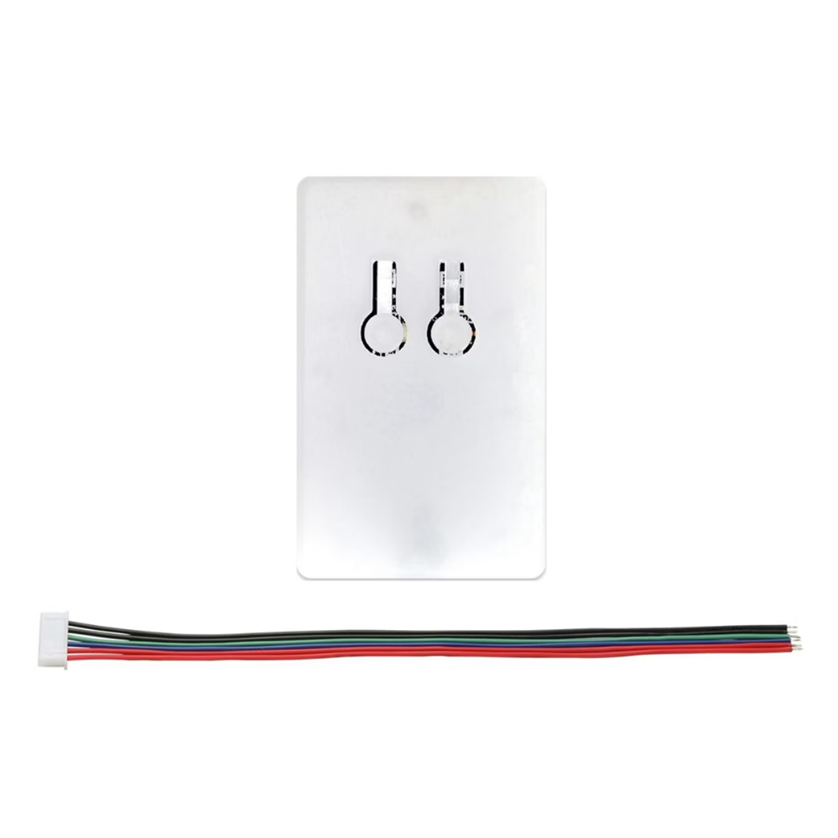

CAN Bus for Software Developers
Controller Area Network (CAN) is a common messaging system in embedded systems. It's widely used in automotive applications for monitoring and controlling vehicle systems. This overview focuses on the software perspective of CAN bus.
by Dave

Slide 2

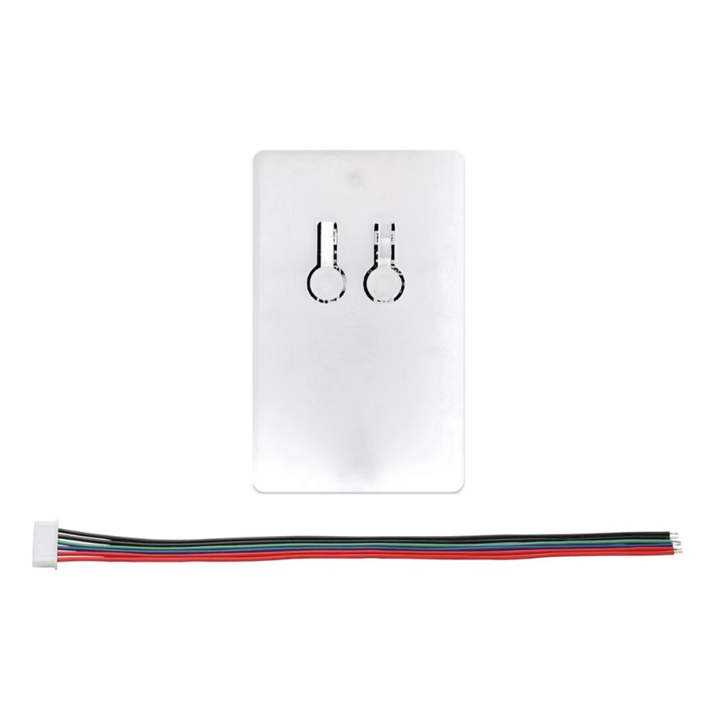
CAN Bus Basics
1
Message-Centric
CAN bus focuses on messages, not nodes. It's a cloud where messages appear and are acted upon.
2
Pub/Sub Architecture
Nodes can publish messages and subscribe to receive them. It's not master/slave or client/server.
3
Short Messages
Message format fits within 8 bytes. IDs are unique and determine priority.

Slide 3


Message ID and Priority
1
ID Assignment
Message IDs are unique across sending nodes. Lower ID value means higher priority.
2
Arbitration
Hardware handles bus arbitration using message IDs. Lower IDs get priority.
3
Transmission
Messages flow according to ID priority. Higher ID messages wait for transmission.

Slide 4
CAN Controllers
Functionality
Complexity
Setup
Modern CAN controllers offer advanced features like error handling and message filtering.
Controller datasheets can be extensive. The TI CAN controller 4550 datasheet is 150 pages.
Basic CAN bus systems can be easily set up in Linux with proper kernel configuration.

Slide 5

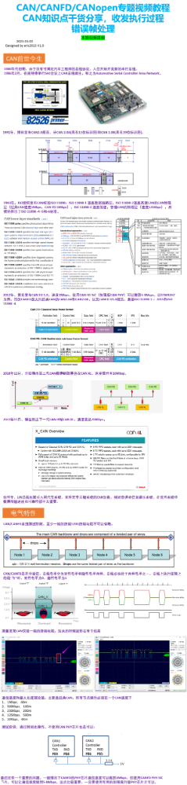
Higher Level Protocols
Ad-Hoc Systems
Simplest systems assign message IDs and formats to components.
CANopen
Used in automation, attempts to turn CAN bus into a node-based system.
Automotive Standards
Includes SAE J1939 and ISO 11898 series specifications.

Slide 6



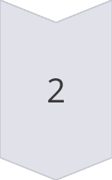

Software Architecture
Message Graph
Design CAN systems using a graph of messages and state machines.
Node Independence
Architecture can be done without specifying physical nodes or CPUs.
Message Allocation
Use spreadsheets to allocate outgoing messages to nodes in the system.

Slide 7




Simple Can Bus App
Virtual CAN Bus
Setting up a virtual CAN bus for Linux.
Libraries
Simple libraries supporting CAN bus access in C and Go.

